Slide 1

Analysis of Global Youtube Statistics Dataset
Submitted By:
Sharon Blessy J V
Indian Institute of Information Technology Tiruchirapalli

Slide 2

Contents of the Dataset:
The dataset provides comprehensive statistics on top YouTube channels, including subscriber counts, video views, upload frequency, country of origin, earnings, and more.
Size of the Dataset:
The dataset contains 1007 rows and 29 columns.

Slide 3
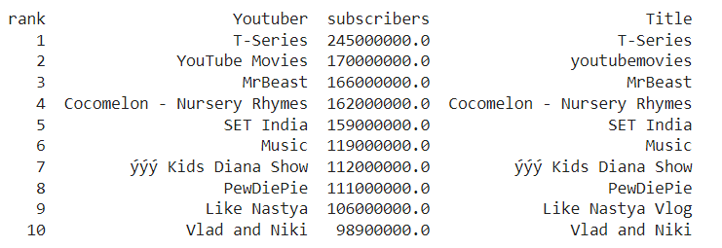

Top 10 Youtube Channels based on the no. of subscribers:

Slide 4
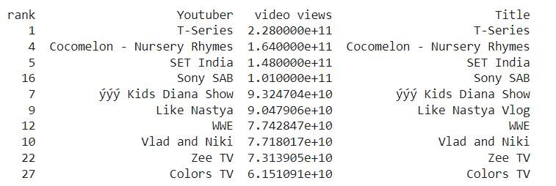
Top 10 Youtube Channels based on the no. of views across all videos:

Slide 5
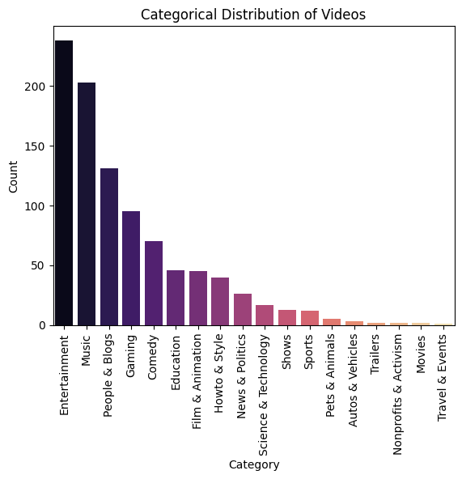
Categorical Distribution of
Videos:
Majority of the videos are of the category entertainment and music.
The least number of videos is about travel and events.

Slide 6
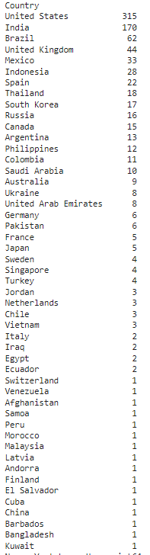

Number of Channels from each country given in the dataset:
United States and India lead the chart.

Slide 7
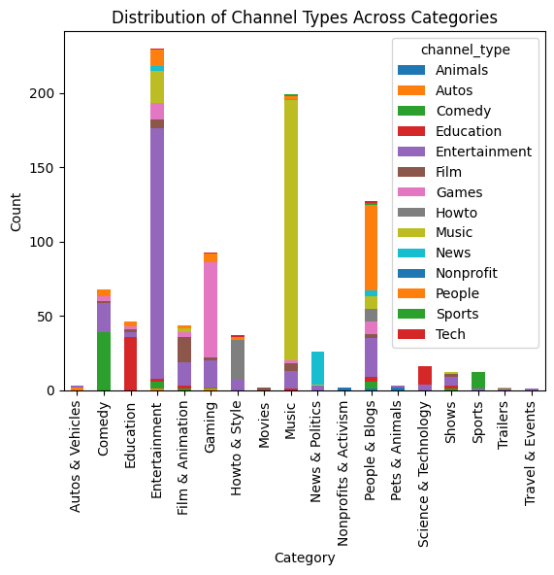
Distribution of Channel Types Across Categories:

Slide 8
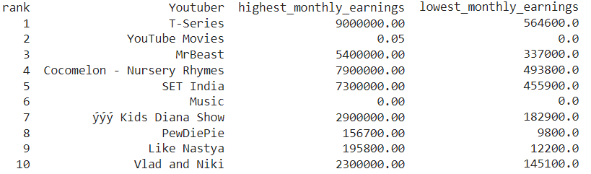
The Highest and Lowest Monthly Earnings of the Top 10 Youtube Channels:

Slide 9
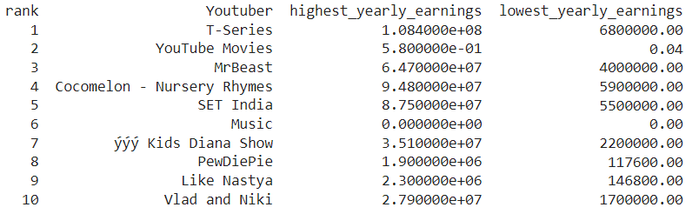
The Highest and Lowest Yearly Earnings of the Top 10 Youtube Channels:

Slide 10
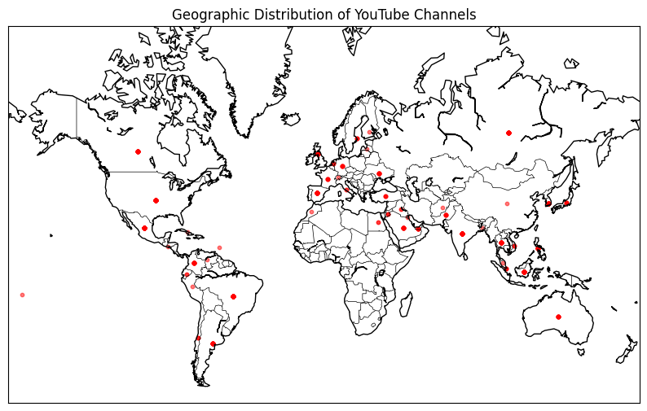

Slide 11
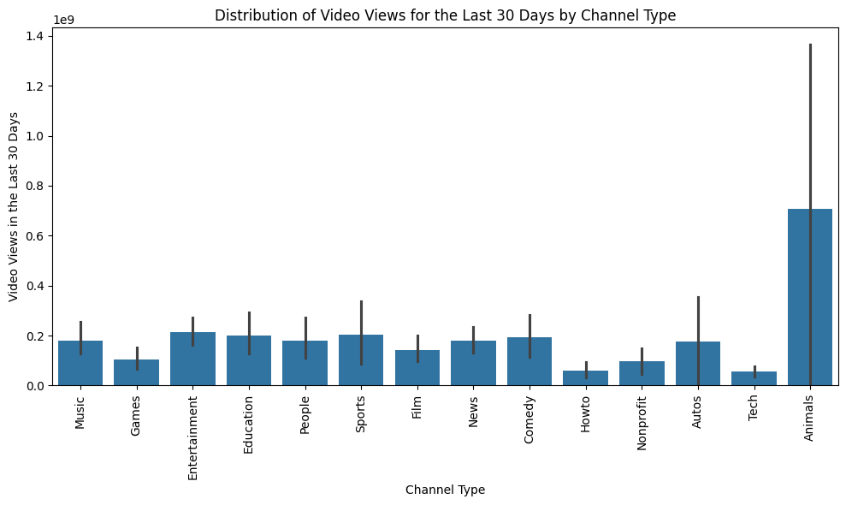

Slide 12
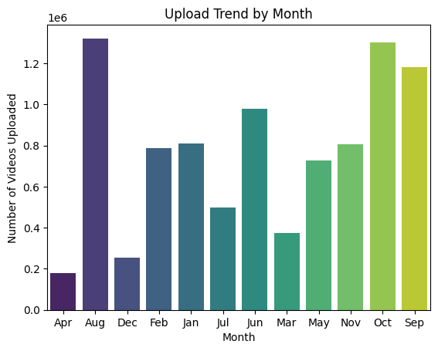
Monthly trends in the number of videos uploaded by YouTube channels:

Slide 13
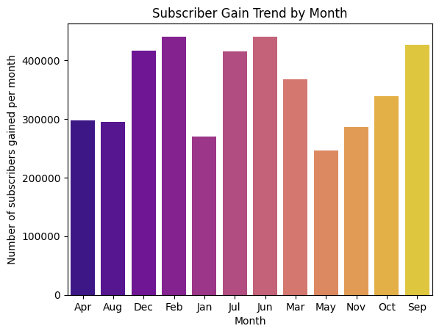
Monthly trends in gain of subscribers in YouTube channels:

